Slide 1

Crowned Jewelers
Conversion Funnel Analysis

Slide 2
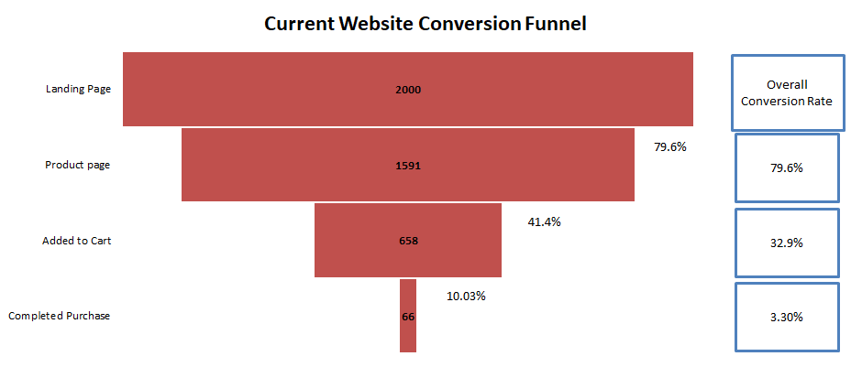
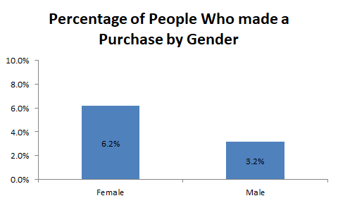
Current Conversion Funnel
Only 10% of the people who put an item in their cart complete their purchase. This is the largest opportunity to improve the conversion funnel
Gender is a significant factor in going from adding to cart to completing purchase

Slide 3
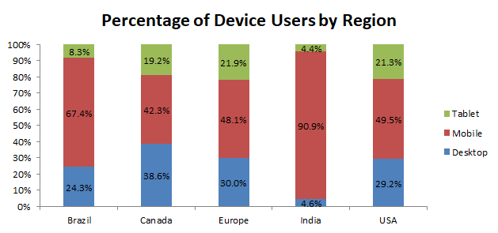
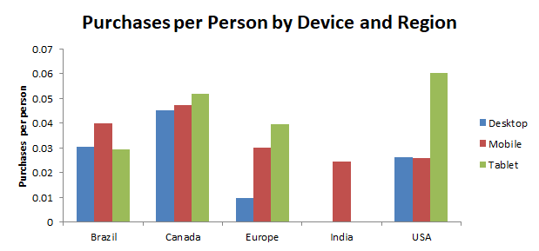
Device Usage by Region
Mobile users are the majority for each region.
Tablets have the most purchases per person yet are the minority for each region in number of users.
The Desktop website for Europe and Desktop and Tablet sites for India need to be investigated and improved upon

Slide 4
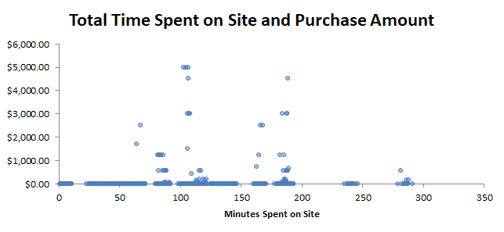
Time Spent on Site
None of our users made a purchase within 60 seconds of spending time on the site.
Most users purchase between 1 to 3.5 minutes of being on site
Users who spend more than 1 minute up to 5 minutes on the site are more likely to purchase products.
Purchase Made | AVG Total Time On Site (Minutes)
No | 61.33793
Yes | 141.0697

Slide 5
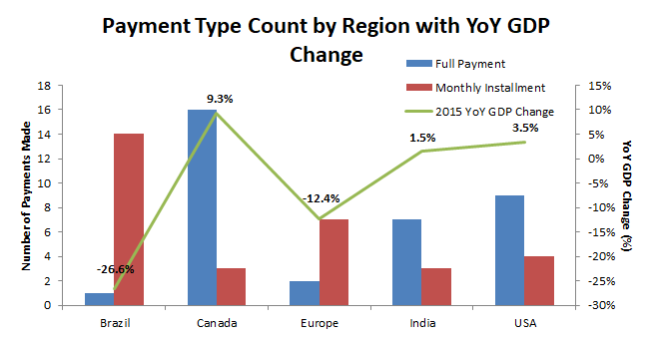
Payment Methods
The regions who experienced a negative YoY GDP change for 2015 favored the monthly installment plans.
For regions that experience negative GDP, we should change the website so that installment plans are more visible.

Slide 6
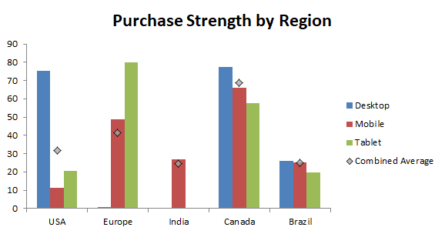
Purchase Strength
Purchase Strength allows us to compare expected sales numbers by multiplying a target population by the purchase strength.
Purchase Strength is $/person multiplied by conversion rate.
Canada has the highest overall purchase strength.

Slide 7
Recommendations
Investigation should be done on what is causing users stop their completion of purchase after adding their product to the cart
The Desktop website for Europe and Desktop and Tablet sites for India need to be investigated and improved upon
Users need to be engaged with our website for at least 1 minute before they will make a purchase
Installments should be recommended for regions that are experiencing declines in GDP growth
Canada is the most attractive market region by value and current conversion rates. Canada would be a valuable target for future marketing campaigns

